Slide 1
WDC Employer Updates
Can’t hear? Dial 1-855-282-6330 toll free and use meeting number: 927 336 276
Please be sure to mute your phone/computer to prevent distracting background noise
This webinar is being recorded and will be posted on the WDC and ETF websites in the coming weeks.
Type your questions in the Chat box.

Slide 2
WDC Employer Webinar
September 19, 2019
Shelly Schueller, ETF Deferred Compensation Director
Emily Lockwood, WDC State Director
Kristy Igl, WDC Retirement Plan Advisor

Slide 3
Today’s Agenda
Introductions & housekeeping
Can’t hear? Dial 1-855-282-6330 toll free and use meeting number: 927 336 276
WDC Overview
Percent and Roth contributions
Online enrollment
Who to contact
Processing contributions
Retirement Plan Advisors, their roles and how to find them
Retirement Review demo
Resources and contact list

Slide 4
Plan Basics
The WDC is a 457(b) plan
Voluntarily for employees earning W2 wages
Before-tax and/or Roth contributions
Dollar amount or percent
No minimum contribution required
Contribution limits are:
$19,000 for everyone;
$25,000 for employees age 50 and older; and
$38,000 for those who qualify and complete paperwork to take advantage of the Special Catchup provision
Notes:
Let’s talk about what a 457(b) plan is.
It is created under Section 457(b) of the Internal Revenue Code. With before-tax contributions, you can set aside some of your income before you pay current taxes. With Roth contributions, you can set aside some of your income after you pay taxes. In 2019, you can contribute up to $19,000 to the WDC or 100% of your compensation (whichever is less).
[Read slide]

Slide 5
Costs for Participants (no employer costs)
WDC participant administrative fees:
Additional services and fees – optional advisory services
Individual investment option operating expenses¹
Account Balance | Monthly Fee | Annual Fees
$1-$5,000 | $0 | $0
$5,001 – $25,000 | $1 | $12
$25,001 – $50,000 | $3 | $36
$50,001 – $100,000 | $6 | $72
$100,001 – $150,000 | $8 | $96
$150,001 - $250,000 | $11 | $132
Over $250,000 | $16.50 | $198
1 Each investment option has its own operating expenses. Funds may impose redemption fees and/or transfer restrictions if assets are held for less than the published holding period. For more information, see the fund’s prospectus and/or disclosure documents.
Notes:
[Discuss the new administrative and plan fees] [Read Slide]
Each of the WDC’s investment option choices also has operating expenses that are deducted from the fund’s assets before the share/unit price is calculated. These expenses pay for the management of the fund, like securities trading and other day-to-day type expenses. Each fund’s expenses differ and are listed on the WDC’s Investment Options at a Glance or in the fund’s prospectus or disclosure documents.

Slide 6
Actions
Enroll
Change contribution amount
Update beneficiary designation
Rollover assets from a qualified retirement plan
Change investment allocations
Take a distribution (upon separation from service)
Call 877-457-9327 or
log on the WDC’s website at www.wdc457.org
Notes:
If you have retirement accounts from a previous employer’s plan and you want to simplify your retirement planning, you can roll over approved balances from those accounts to the WDC.
You may want to discuss any rollovers you may be thinking of making with your financial or tax advisor before making this decision.

Slide 7
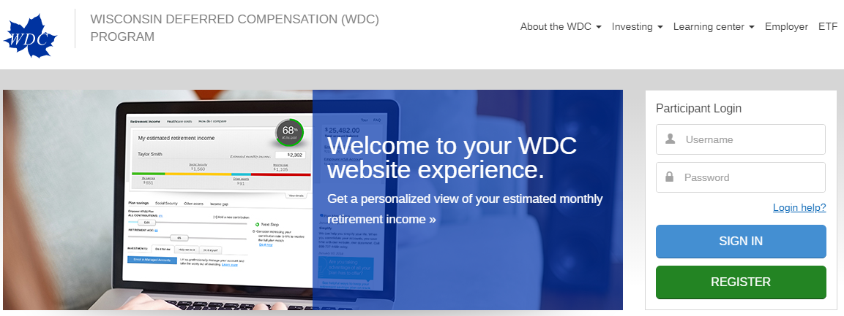
Online Enrollment & Contributions
Plan Enrollment Code – Found in the WDC’s Plan Service Center under Participants then Employee Forms
Code changes three times per year for security
Employees can enroll online or over the phone with the code
Online:
Click Enroll online by clicking REGISTER on www.wdc457.org
Click I have a plan enrollment code
Enter Plan Number: 98971-01
Notes:
You can only withdraw money from the WDC under certain circumstances: when you retire, when you separate from service, if you suffer a financial hardship, when you reach age 70½, or if you die. The 10% federal early withdrawal penalty does not apply to 457 plan withdrawals except for withdrawals attributable to rollovers from another type of plan or account.
When you’re ready to retire, there are many ways for you to receive your account assets. You can take your assets all at once as a lump-sum payment, or you can spread out your distributions over time with periodic payments. These options are discussed at length in another seminar or I can provide you with more information on distribution options when you’re ready to make that decision.
You may want to discuss any withdrawals you may be thinking of making with your financial or tax advisor before making this decision.

Slide 8
Retirement Readiness
Retirement Readiness Review includes:
One-on-one meeting with local WDC Retirement Plan Advisor
Review of personal data and establish goals
Discussion of outside investments and expenses with projected income and cash flows throughout retirement
Analysis and diagnosis in areas of improvement and recommendations to help strengthen the savings rate and investment strategies
A detailed spend-down plan for participants within 10 years of normal retirement age
Notes:
The WDC Program includes an innovative education curriculum focused on retirement readiness. The Retirement Readiness Review is designed to assess where you stand today and the current path you are taking toward retirement. The review includes an individual one-on-one meeting with a local WDC Retirement Plan Advisor who will analyze a variety of factors and diagnose your situation — identifying areas for improvement and making specific recommendations to help strengthen your savings rate and investment strategies.
During the review, you and the local WDC Retirement Plan Advisor will review personal data and establish goals. Together, you will discuss outside investments, pension and Social Security estimates, spouse and partner retirement benefits and other potential sources of retirement income. After factoring in expenses like healthcare and college tuition, an analysis will be conducted that may help you decide if you are on track to reach you desired level of retirement income. The analysis provided will give you a detailed look at your projected income and cash flow throughout retirement. You will receive a detailed spend-down plan that offers suggestions for which retirement income sources to draw from each year of your retirement, depending on your tax situation and other variables.
If a review reveals that you may need to adjust your savings strategy, you will be given suggestions that might help you get back on track, such as increasing your savings rate or changing their investment allocation.
Even if you are already retired, a Retirement Readiness Review can help, too. The review is particularly helpful with spend-down strategies — which can be one of the most neglected parts of retirement planning. For those nearing or in retirement, a review helps you realize what a sustainable income level may be throughout retirement and where the income may come from. It can also help determine appropriate investment strategies and analyze the value of keeping assets in the WDC. An analysis of your spend-down strategies, including illustrations of how long your money might last, is included at no additional cost to you if you are within 10 years of retirement.
Scheduling a Retirement Readiness Review with a local WDC Retirement Plan Advisor is easy! Go to the WDC website, www.wdc457.org, and click on the Schedule a Meeting link. You may also call the WDC at (877) 457-WDCP (9327), press 0 and say “representative.”

Slide 9
Retirement Readiness Review Demo
Kristy Igl, Retirement Plan Advisor

Slide 10
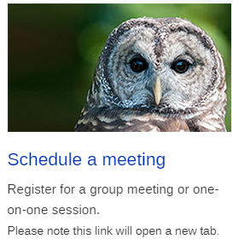
Scheduling a meeting
www.WDC457.org
(877) 457-9327

Slide 11
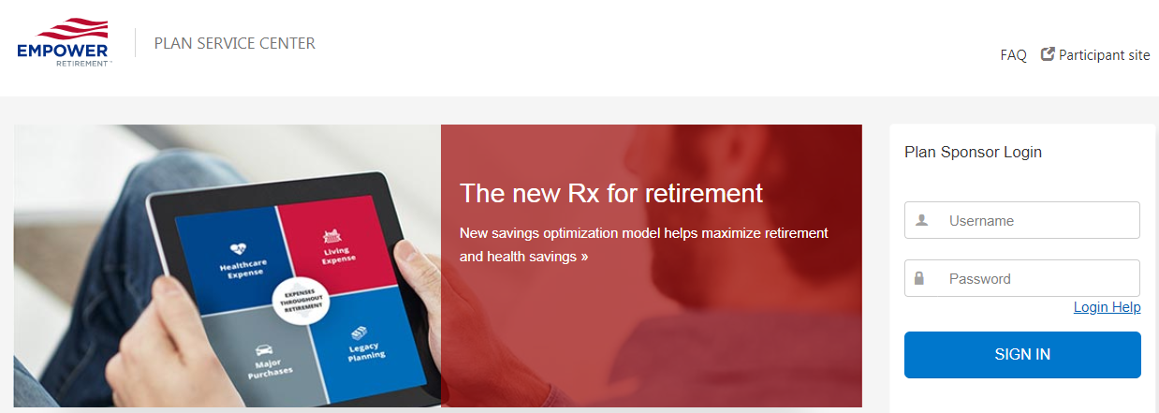
Processing WDC Contributions
WDC’s Plan Service Center
Log in
No Credentials? Contact Kathy Castle, (303) 737-1791
Kathy.castle@empower-retirement.com
Go to MyReports
Open report
Make necessary changes in payroll system
Go to Process Contributions
Submit contribution detail manually or via file
ACH debit for payment
Plan Technical Support: 800-695-4952 (choose “website support”)

Slide 12
Entering Termination Dates
WDC’s Plan Service Center
Log in
No Credentials? Contact Kathy Castle, (303) 737-1791
Kathy.castle@empower-retirement.com
Go to Participants
Search Employee
Click the Employee detail tab
Scroll to Employment Information
Click Edit
Enter termination date, select reason (normally Sep Serv or Retirement) and click Save
Plan Technical Support: 800-695-4952 (choose “website support”)

Slide 13
WDC Employer Contacts
Madison WDC office: (608) 241-6604 (press 2)
Kathy Castle: (303) 737-1791
Kathy.castle@empower-retirement.com
Shelly Schueller, ETF Deferred Compensation Director
Shelly.Schueller@etf.wi.gov or (608) 266-6611

Slide 14
WDC Website Resources and References
www.wdc457.org
Employer Toolkit (Adopting the WDC) – Employer Tab
Benefits of Enrolling – About the WDC Tab
WDC Employer Newsletter – 2019 – Employer Tab
WDC Employer Guide (Payroll) – Employer Tab

