Slide 1

“Investments 101” for Women
September 23, 2015
Department of Employee Trust Funds
Wisconsin Deferred Compensation Program

Slide 2

Why Focus on Women?
“The largest growing segment of our population is poor, elderly women.”
--Teresa Heinz Kerry

Slide 3
Issues Unique to Women
Earn less
Time away from work
Part-time work
Less in savings and pension
Live longer
Living alone in retirement

Slide 4
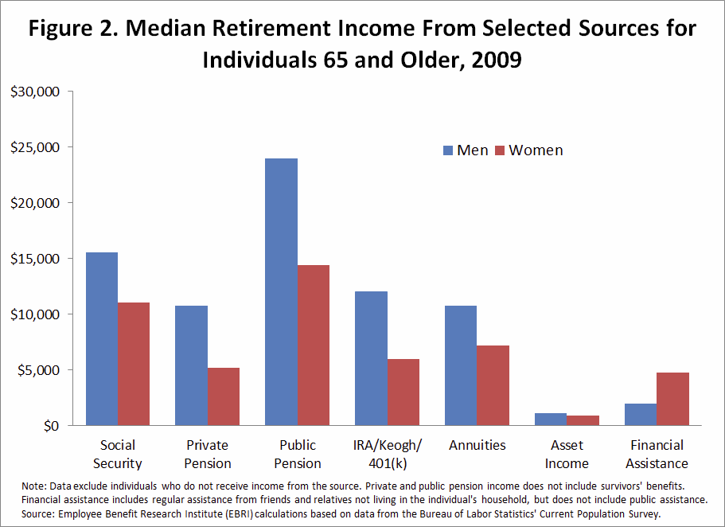
Retirement Income

Slide 5
Wisconsin
Nearly two-thirds of all households in poverty in Wisconsin are headed by single women.
Among older adults in Wisconsin, women outnumber men among the poor at a rate of more than two to one.

Slide 6
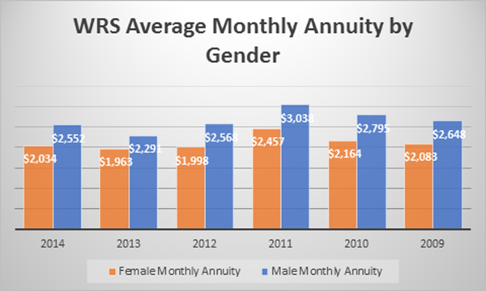
Wisconsin Retirement
System Annuities

Slide 7
Some Women Can Lack
Investing Confidence
43% of women say they don’t know if they are on course for retirement.
20% of women overall feel they are on course for a secure retirement.
“The future belongs to those who believe in the beauty of their dreams.”
Eleanor Roosevelt

Slide 8
Basic Investment Education
Kristy Igl, Retirement Plan Counselor
Wisconsin Deferred Compensation Program
1 Certificates of deposit are insured by the FDIC for up to $250,000 per depositor and offer a fixed rate of return, whereas both the principal and yield of bonds and stocks will fluctuate with market conditions.
2 An investment in a money market fund is not insured or guaranteed by the Federal Deposit Insurance Corporation or any other government agency. Although the fund seeks to preserve the value of your investment at $1 per share, it is possible to lose money by investing in the fund.
3 Generally backed by the general assets of the issuing insurance company.

Slide 9

Cash Alternatives
Help preserve principal from
market fluctuations
Balance stock portion of portfolio
Larger percentage of portfolio closer to retirement
Examples:
  Savings accounts and CDs¹
  Money market investments²
  Guaranteed accounts³
  Stable value investments
1 Certificates of deposit are insured by the FDIC for up to $250,000 per depositor and offer a fixed rate of return, whereas both the principal and yield of bonds and stocks will fluctuate with market conditions.
2 An investment in a money market fund is not insured or guaranteed by the Federal Deposit Insurance Corporation or any other government agency. Although the fund seeks to preserve the value of your investment at $1 per share, it is possible to lose money by investing in the fund.
3 Generally backed by the general assets of the issuing insurance company.

Slide 10

Bonds
What they are
Fixed income securities
Lend money to bond issuer
Repaid on certain date—with interest
Receive regular interest payments
Issued by companies and governments
How they work
Generally offer lower potential returns than stocks
Help diversify portfolio¹
1 Diversification of an investment portfolio does not ensure a profit and does not protect against loss in declining markets.

Slide 11
Stocks
Highest potential returns, high risk
Part of long-term portfolio¹
Volatility—market ups and downs
Stock dividends
Part owner (share equity)
Dividend payment represents share
of earnings
Smaller companies may reinvest earnings

Slide 12

Market Capitalization
Multiply the number of shares outstanding by the stock’s
current price
Large cap: large, established, generally pay dividends
  Market capitalization of greater than $10 billion
Mid cap¹: established, yet innovative and responsive
  Market capitalization in the $2 billion to $10 billion range
Small cap¹: new, cutting-edge, potential for rapid growth
  Market capitalization below $2 billion
EXAMPLE:
5 million shares
x $20 per share
$100 million
1 Equity securities of small and mid-sized companies may be more volatile than securities of larger, more established companies.

Slide 13

International Stocks¹
Companies outside the United States
Both high risk and return potential
May fluctuate in value opposite to U.S. stocks
May invest a portion in the U.S.
1 Foreign investments involve special risks, including currency fluctuations and political developments.

Slide 14

Risk vs. Return Potential
Cash Alternatives/Bond Funds/Stock Funds
Lower Risk/Lower Return Potential
Higher Risk/Higher Return Potential
Money Market Funds
Intermediate U.S. Government Bonds Funds¹
Corporate Bond Funds¹
Large-Cap Funds
Mid-Cap Funds²
Small-Cap Funds²
International Funds³
An investment in a Money Market Fund is not insured or guaranteed by the Federal Deposit Insurance Corporation or any other government agency. Although the Fund seeks to preserve the value of your investment at $1.00 per share, it is possible to lose money by investing in the Fund.

Slide 15

Investment Risks
Market Risk
Business Risk
Inflation Risk
Interest Rate Risk
International Risk
Not Investing Risk

Slide 16

Manage Risk
Diversify through asset allocation¹
Invest consistently
Invest for the long term
1 Diversification, asset allocation and dollar cost averaging do not ensure a profit and do not protect against loss in declining markets.

Slide 17
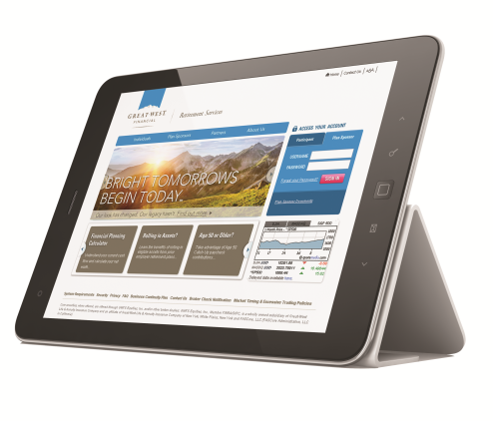
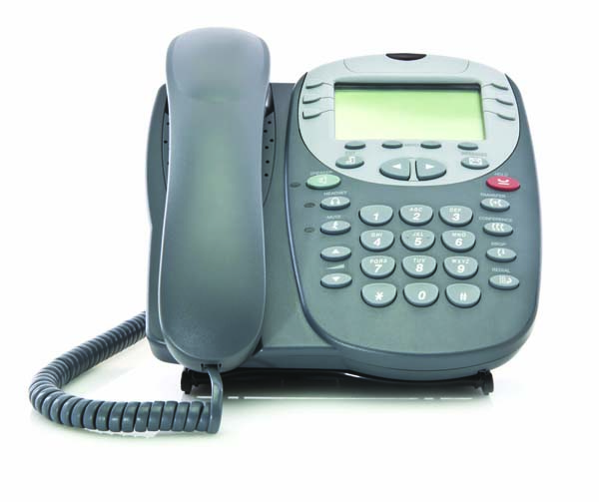
The WDC is here to help!
Call us -- KeyTalk^{®1}
  (877) 457-9327, press 0
Website¹
  Visit
  www.wdc457.org
Online Tools you can use
  Calculators
  Internet sites
  Financial articles
1 Access to KeyTalk and/or any website may be limited or unavailable during periods of peak demand, market volatility, systems upgrades/maintenance or other reasons.

Slide 18

9 Reasons to Save for
Retirement with the WDC
Easy enrollment
Tax-deferred and Roth savings options available
Low cost ($0 if under $5,001)
Variety of quality investment options
Convenient account management
Personal and professional service
Savings and investment education available throughout your career
Flexible withdrawal options
Your future self will thank you!
Enroll today. It’s that simple!

Slide 19
Core securities, when offered, are offered through GWFS Equities, Inc. and/or other broker dealers.
GWFS Equities, Inc., Member FINRA/SIPC, is a wholly owned subsidiary of Great-West Life & Annuity Insurance Company.
Empower Retirement refers to the products and services offered in the retirement markets by Great-West Life & Annuity Insurance Company (GWL&A), Corporate Headquarters: Greenwood Village, CO; Great-West Life & Annuity Insurance Company of New York, Home Office: White Plains, NY; and their subsidiaries and affiliates. The trademarks, logos, service marks, and design elements used are owned by their respective owners and are used by permission.
Representatives of GWFS Equities, Inc. are not registered investment advisors and cannot offer financial, legal or tax advice. Please consult with your financial planner, attorney and/or tax advisor as needed.
©2015 Great-West Life & Annuity Insurance Company. Form# S1001 (07/2015) PT235018
Unless otherwise noted: Not a Deposit | Not FDIC Insured | Not Bank Guaranteed | Funds May Lose Value |
Not Insured by Any Federal Government Agency

Slide 20
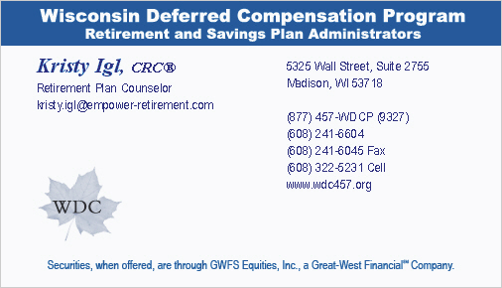
Questions?
Insert business card graphic here or photo of presenter
Kristy Igl
WDC Retirement Plan Counselor
(608) 241-6604, Ext. 7713
kristy.igl@empower-retirement.com
Empower Retirement

Slide 21
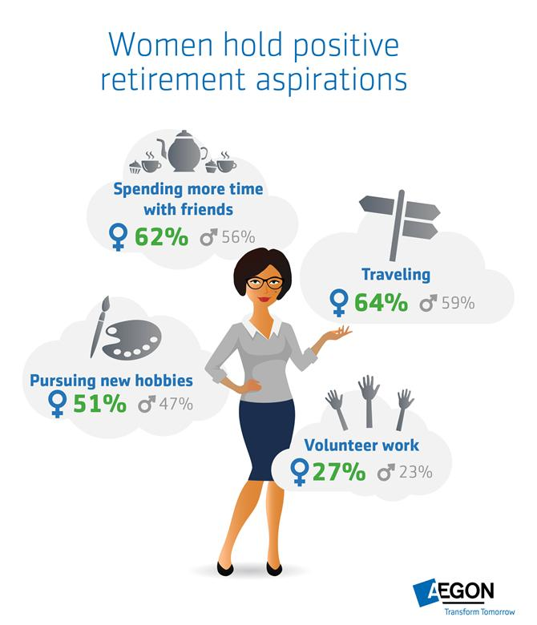
Women are Positive
About Retirement

Slide 22
Get To Know Your Sources of Retirement Income
Social Security:
  http://www.ssa.gov/myaccount
The WRS – your employer-sponsored retirement plan: http://etf.wi.gov
Other savings and investment accounts (like the WDC and 401(k)s, IRAs, etc.)
What do you AND your spouse/partner have?

Slide 23
Get Help if You Need It
Learn the basics of investing and retirement planning – good, basic information can go a long way!
Work with someone who can help – the WDC or your financial advisor.
Talk to each other and share your experiences

Slide 24
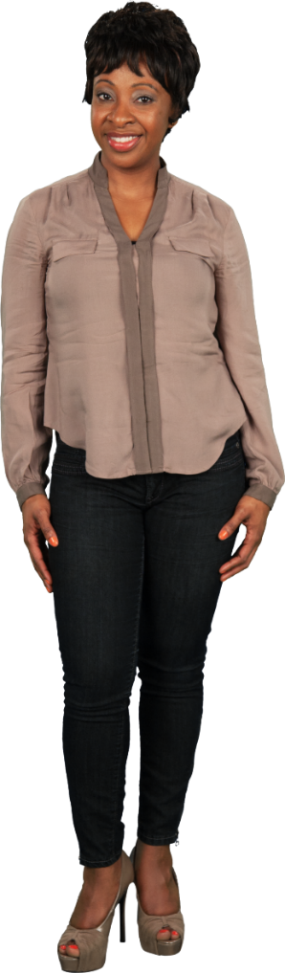
EMPOWER
Resources
Online at:
http://etf.wi.gov/empower/
Follow ETF on Twitter: @WI_ETF

Slide 25

For more on the WDC:
Kristy Igl, Retirement Plan Counselor
Email: kristy.igl@empower-retirement.com Ph. 608-241-6604, Ext. 7713
For more on EMPOWER:
Tarna Hunter and Shelly Schueller
Department of Employee Trust Funds
Email: ETF_EMPOWER@etf.wi.gov
ETF EMPOWER website: etf.wi.gov/empower

