Slide 1
5 Basic Steps to Your Retirement
Wisconsin Retirement System
http://etf.wi.gov

Slide 2
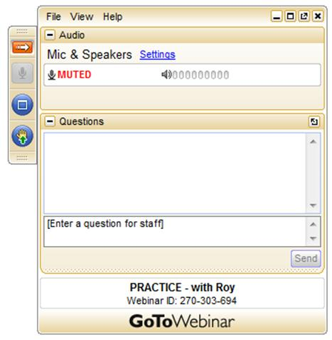
How to Participate in the Webinar
When you log in your dashboard will look like this:
It will minimize
Press the red arrow to restore the dashboard
You will be muted for the entire webinar
Use the question function to ask questions once the presentation has ended

Slide 3
Topics For Today
A short summary of what will be presented.
A listing of the basic steps to help you begin your retirement.
A quick review and a list of helpful resources.

Slide 4
Summary of This Webinar
This is a very basic and quick reference guide for where you should start if you are interested in retiring within the coming 12 months.
We will discuss the minimal but very necessary steps required to request your retirement estimate and what to do once you have that estimate.
Additional resources will be listed for anyone requiring more in-depth information.

Slide 5
5 Basic Steps to Your Retirement
Choosing your termination date
Requesting your estimate
Reviewing your estimate
Scheduling your appointment
Submitting your application

Slide 6
Choosing your Termination Date
Money Purchase or Formula
Interest rates are important for Money Purchase benefits
Completing a full year may be beneficial for Formula benefits
Unused Vacation or Leave Time
Using time, taking cash payout, or a rollover (varies by employer)
Health Insurance Benefits
Does your term date affect your health insurance? Life insurance?
Final Additional Contribution
Deadlines for any allowable post & pre tax contributions
***View our webinars “Choosing When to Retire” & “Retirement Benefit
Calculation Methods” for more information.

Slide 7
Requesting your Estimate
Must be within 1 year of age 50 or 55
Protective categories have earlier retirement eligibility
Call 877-533-5020 Toll-Free
Or local Madison – Call 608-266-3285
Contact via secure email at etf.wi.gov
Written request via US Mail
PO Box 7931 Madison WI 53707-7931
Provide your name, birth date, ss #, termination date, joint survivor’s name & birthdate, pre-1974 active duty military, and current salary estimate

Slide 8
Reviewing your Estimate
Open the packet envelope
Read your estimate/application form
Browse through the brochures
Write down any questions you have
Is there a current beneficiary form on file? When do payments start
and when do they arrive? Taxes? Other deductions? What is the
difference between a beneficiary and a joint survivor?
***View our webinar “Annuity Options” for specific information

Slide 9
Scheduling your Appointment
Is this mandatory? NO
But it is extremely helpful.
Is this recommended? YES
Members have commented how much easier it is to navigate through our system
with the help of an in-person appointment.
Avoid costly mistakes and receive clear, easy to understand explanations and answers to your questions.
Contact ETF to schedule either your group or individual appointment at 877-533-5020

Slide 10
Submitting your Application
FAX to 608-267-4549
or
Mailing address for Employee Trust Funds PO Box 7931 Madison WI 53707-7931
or
In person to our Madison office located at 801 W Badger Rd Madison WI 53713

Slide 11
Review Your 5 Steps
Choose your termination date
Request your estimate
Review your estimate
Schedule your appointment
Submit your application

Slide 12
Additional Resources
Contact ETF:
PO Box 7931 Madison WI 53707-7931
877-533-5020 or 608-266-3285
etf.wi.gov
Available webinars for additional information:
Annuity Options, Additional Contributions, Buying Service, Retirement Benefit Calculations, Choosing When to Retire, Beneficiary Designation, Using the On-Line Calculator, Variable Fund and Return to Work Rules

Slide 13
Thank you for participating today and best regards to each of you that are about to retire.
To those of you not quite ready to retire but are merely interested in finding out information, please refer to the webinars mentioned on the additional resources slide and please do not hesitate to contact our office for further information.

